Slide 1
HTML and Dynamic HTML
Module 03 - Commonly used tags.

Slide 2
Prelude
As we have seen in the previous chapters, all websites in the world are composed of tags. However, the tags we have learned before are not the only ones.
This chapter will introduce several other commonly used tags, and attributes commonly used with them.

Slide 3
Elements - Basics
HTML Elements mostly consist of open tag:
<>
and close tag :
</>
example:
<body></body>
<canvas></canvas
<script></script>
<div></div>
<h1></h1>
<h2></h2>

Slide 4
Elements - Basics
On the other hand, we will sometimes find elements that uses only the close tag
example:
<br />
<link />
<param />
<img />
<input />

Slide 5
Elements - Basics
There are some important concepts about HTML Elements. One of them is the difference between:
Inline Elements and Block Elements

Slide 6
Inline Element
Inline Elements are elements which occupies only the space bounded by the tags that define them. For understanding we will explain with example:
If we have an opening and closing tag like this:
<span> </span>
And we want to color its background with red:
< span style=“background-color:red”> COLOR ME ! </span >
The red color will only imply only on the Text that between the opening tag and closing tag

Slide 7
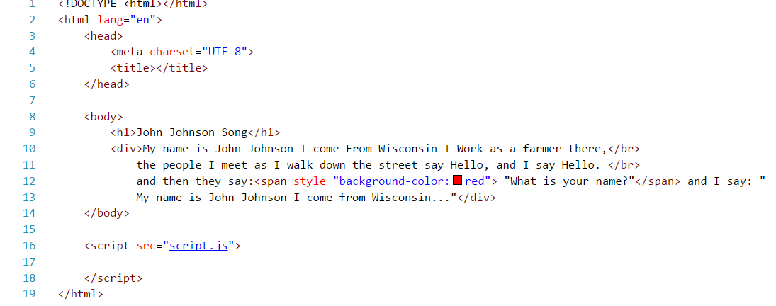
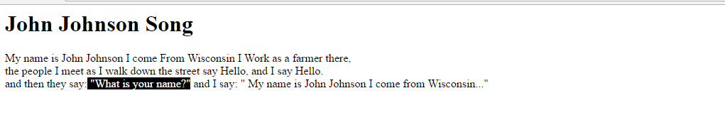
Code Example and Result- Inline Element

Slide 8
Block Element
The Block Elements will behave differently from the Inline Elements. The Block Elements will always start on a new line and takes the full width available. We will show example:
<div style=“background-color:blue> Color me <div>
This will color the whole line where the div is declared

Slide 9
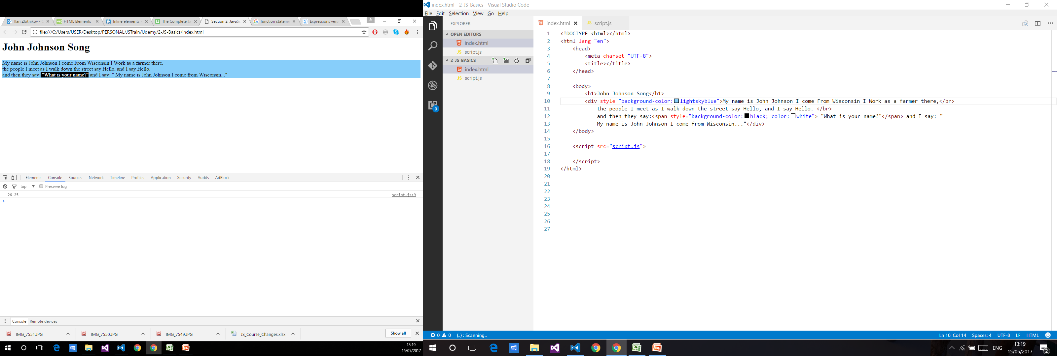
Code Example and Result- Bock Element

Slide 10
Image tag
An image tag (<img>) is used to link an image to the user. Image files use the following attributes:
Src attribute – This attribute is used to determine the source of the image.
Alt attribute – This attribute is used to set text that is relevant to the image. In the event the image cannot load, the text will be displayed instead.

Slide 11
Image tag
Example of Image tag usage:
Full Image Path -
<img src="http://www.sela.co.il/_pics/logosela.jpg" alt="Sela Logo"/>
Relative Image Path –
<img src="pictures/myPicture.jpg" alt="A picture in my site"/>

Slide 12
Links and Anchors
The Anchor tag (<a>) can be used to redirect the user to either other pages or redirect to another element in the website.
This can be useful for giving the user navigation options.
The main attribute for the anchor tag is href.
Href allows you to set the target.
Notes:
The Anchor tag (<a>) can be used to redirect the user to either other pages or websites, or redirect to another element in the webpage.

Slide 13
Redirecting to other pages and websites.
In order to redirect to other pages on the same website, or even on other websites, the href will need to direct to that page.
Full path:
<a href="www.sela.co.il">This is a link to the Sela website.</a>
Relative path:
<a href="otherPages/myOtherPage.html">This is a link to my other page.</a>

Slide 14
Anchors
In order to facilitate navigation within a webpage we can use the <a> tag to navigate to specific locations within our webpage.
First we will need to set another tag as the recipient for the navigation. This can be done by giving the target the id attribute.
Example:
<div id="myDiv"></div>
We will then need to set up the appropriate anchor tag with an href with # followed by the id of the target.

Slide 15
Anchors example:
<a href="#topOfPage">Click here to go to the top.</a>
<a href="#bottomOfPage">Click here to go to the bottom.</a>
<div id="topOfPage">
…
</div>
…
<div id="bottomOfPage">
…
</div>

Slide 16
Lists
In HTML we are able to create bullet point lists.
This can be used to give example of things, provide different links, list recommended items and more.
In order to facilitate this we have two types of lists, an unordered list, and an ordered list.

Slide 17
Ordered lists
Ordered lists use the <ol> tag.
We can use ordered lists to list things numerically.
Examples for use in ordered list could be- steps in a recipe or a list of top ranked films.
All items inside the ordered list must use the <li> tag.
We can optionally use the start attribute in order to start from a number that is higher then 1.

Slide 18
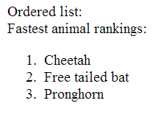
Ordered lists Example
<div>Fastest animal rankings:</div>
<ol>
<li>Cheetah</li>
<li>Free tailed bat</li>
<li>Pronghorn</li>
</ol>

Slide 19
Unordered lists
Unordered lists use the <ul> tag.
Unordered lists display items in bullet points.
Examples for use for an unordered list could be ingredients in a recipe, list of actors and other things in which order does not matter.
All items inside the unordered list must use the <li> tag.

Slide 20
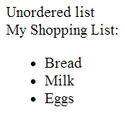
Unordered lists Example
<div>My Shopping List:</div>
<ul>
<li>Bread</li>
<li>Milk</li>
<li>Eggs</li>
</ul>

Slide 21
Select
In order to make a drop down box, we can use the <select> tag.
We can then populate it with <option> tag items.
Each option item has a value attribute, and a display text which is between the start and end tag.
Additionally an option tag can have the selected attribute. This will make it behave as the default selection.
In order to allow selecting multiple options we can give the multiple select attribute on the select tag the value of true.

Slide 22
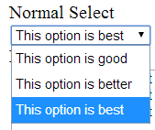
Select Example
<select>
<option value="goodOption">This option is good</option>
<option value="betterOption">This option is better</option>
<option value="bestOption" selected="selected">This option is best</option>
</select>

Slide 23
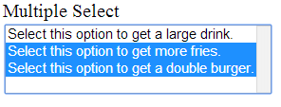
Select multiple Example
<select multiple="multiple">
<option value="bigCup">Select this option to get a large drink.</option>
<option value="bigFries">Select this option to get more fries.</option>
<option value="doubleBurger">Select this option to get a double burger.</option>
</select>

Slide 24
Inputs
The <input> tag allows us to add controls which allow various forms of user input. This chapter will only server to introduce some of them, but they will be touched on more heavily in a later chapter.
The input tag allows users to interact with our website, by exposing controls allowing them to make choices and type in text.
The type of control is determined by the value of the type attribute.
Here are some of the commonly used ones:

Slide 25
Input Button
When input type is button, a button will be rendered. The button can be used to implement button behaviors.
Value allows setting the button text.
Example:
<input type="button" value="My Button" />

Slide 26
Input Text
This input acts as a text box, allowing for user input to be added.
Value determines initial text.
Example:
<input type="text" value="Initial Text"/>

Slide 27
Input Checkbox
This input acts as a checkbox, allowing checking and unchecking. Note that this control requires a separate label.
The checked attribute determines if the box is checked.
Value is the actual value the checkbox represents.
Example:
<input type="checkbox" checked="checked" value="iAmChecked" />

Slide 28
Input Password
This input acts similarly to textbox, however all text in a password field is obscured.
Value is the text inside the password box.
Example:
<input type="password"/>

Slide 29

Input Radio
Using the radio input we can make multiple radio buttons, of which only one can be selected at any time. The actual scope for the buttons is determined by the name attribute.
Value determines the value of the buttons.
Example:
<input type="radio" name="color" value="blue"/>Blue
<input type="radio" name="color" value="red"/>Red
<input type="radio" name="shape" value="square"/>Square
<input type="radio" name="shape" value="triangle"/>Triangle

Slide 30
Form tag
A <form> tag is a special type of tag that is used for containing multiple input tags inside it.
If we add a special input tag with the type submit, it will allow us to send data via query string.
A query string is a special string that is added to the page address and allows us to send parameters to a refresh.
An additional feature of the form is that all inputs inside it are independent of inputs in other forms.

Slide 31
Using external CSS files
A big problem with using the style attribute to change the appearance of controls on our page is that the page quickly becomes very full and cluttered.
As a result it makes reading it much harder, and changing a style requires changing it for all controls using it.
For this purpose we can choose instead to include external CSS files.
Note that it is possible to have several external CSS files as well as inside the page itself. The order of the files and inline CSS as it is ordered inside the page, will determine the final result. The last CSS definition wins, as these are CSS (Cascaded).
Notes:
The basic recommendation is to separate the structure (HTML) from the styling (CSS) and from the behavior (JavaScript), to different files.
This will allow easier reading and editing of the website by the developer side.

Slide 32
How to add CSS files
In order to add a reference to an external style sheet we will use the <link> tag.
The link tag should be included in the head of the html file.
The link tag has the following important attributes:
href – This allows us to link either the relative or partial path to our CSS file.
Rel – Determines the relation between the link and our page. In the case of CSS files, we should use Stylesheet.

Slide 33
CSS File format
CSS is composed of the following components: A selector, and one or more descriptors.
The selector determines what parts of the HTML does the CSS affect.
The descriptor determines what styling properties will be applied to the elements.
Example:
selector {
property:value;
property:value;
}

Slide 34
Tag Selector
The first type of selector is the tag selector.
The tag selector affects styling for all elements of a certain tag.
This allows us to set universal styling for elements in our website, which will unify the behavior according to tags.
The tag selector is identical to the name of the tag.
Example:
div {
background-color:blue;
}

Slide 35
Class Selector
The most commonly used type of selector.
The class selector affects styling for all elements of a certain class.
Class is an attribute that can be applied to any visual HTML elements.
This allows us to create styled classes which can be used to create specific display behavior, and implement it to any element.
The class selector is a dot(.) followed by the class name.
Example:
.myClass {
font-size:12px;
}

Slide 36
ID Selector
Another commonly used selector.
The id selector affects styling an individual element with a matching id.
ID is an attribute that can be applied to any visual HTML elements, as an important note, ID should always be unique.
This allows us to style a specific element.
The id selector is a number sign(#) followed by the id.
Example:
#myId {
font-size:30;
font-weight:bold;
}

Slide 37
Descendent selectors
Selectors can also be applied to all the elements under a specified condition without affecting the element itself. This I called descendent selector.
An example would be if we want to style all divs that appear under a class name.
We can apply descendant selectors between adding a space after the parent.
This will be done in the following manner:
.myClass div{
background-color:red;
}
Notes:
More details on chaining and other usages of selectors can be found here:
CSS Selector Reference (on google).
http://www.w3schools.com/cssref/css_selectors.asp

Slide 38
Chaining selectors
It is possible to apply more then one selector to an element, thus causing them to apply to very specific elements.
An example would be if we want all divs with the class blueFont to also be underlined.
This will be done in the following manner:
div.blueFont{
text-decoration: underline;
}
Notes:
More details on chaining and other usages of selectors can be found here:
CSS Selector Reference (on google).
http://www.w3schools.com/cssref/css_selectors.asp

Slide 39
Grouping selectors
It is possible to apply selectors to more than one element.
An example would be if we want all divs and all <h1> tags to be underlined.
This will be done in the following manner:
div, h1{
text-decoration: underline;
}
Notes:
More details on chaining and other usages of selectors can be found here:
CSS Selector Reference (on google).
http://www.w3schools.com/cssref/css_selectors.asp

Slide 40
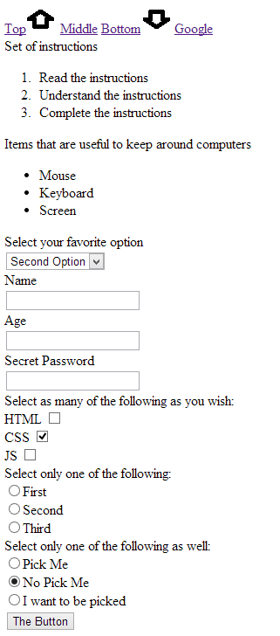
Exercises
Create the controls on this page.

Slide 41
Exercises
Controls should behave as they appear on the screen.
The select box should have at least two options.
The password box should only show password symbols.

Slide 42
Exercises
In this exercise we will style the previous exercise.
You must use at least one of each selector.
You must use at least one chained selector.
Style the entire page to your liking.
You may not use any inline style.

Slide 43
Exercises
At the top of the page should be 4 links. Top, Middle, Bottom and google, the arrow images should be part of the link.
Pressing on the top link will move you to the top of the page.
Pressing on the middle link will move you to the set of instructions.
Pressing the bottom link will move you to the select box.
Pressing on google link will redirect you to www.google.com page.

